Slide 1

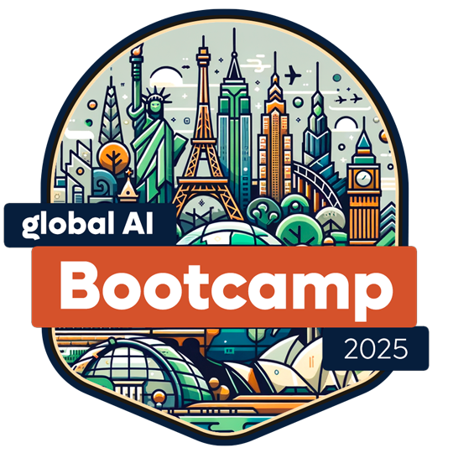
From nothing to full AI applications with Semantic Kernel in .NET 9
Global AI Bootcamp 2025 Bangkok
Emiliano Montesdeoca del Puerto
Microsoft MVP in Developer Technologies
Cloud Dev Team Lead @ Intelequia
@emimontesdeocaa
blog.emilianomontesdeoca.com

Slide 2
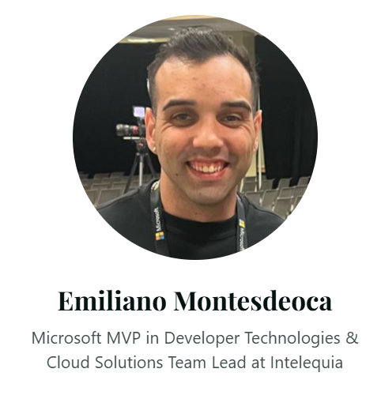
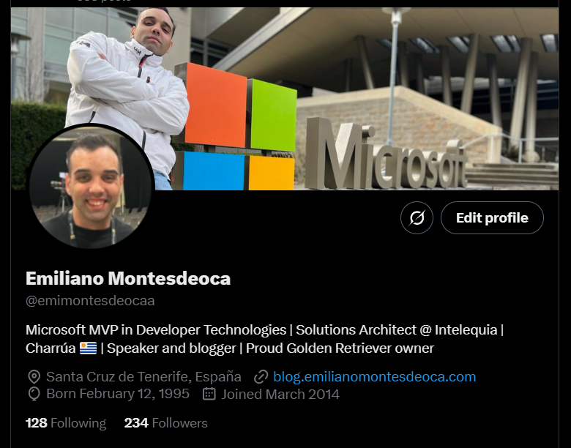
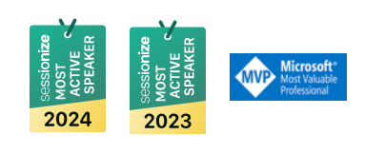

You can call me Emi
Uruguayan
Microsoft MVP
Cloud Dev Team Lead
@emimontesdeocaa
Global AI Bootcamp 2025 Bangkok
@emimontesdeocaa
Notes:
My name is [Speaker name], [Speaker title] at [Speaker company] .
My name is [Speaker name], [Speaker title] at [Speaker company] .

Slide 3
How do I make my dumb app smart?
Your boss would tell you that…
Global AI Bootcamp 2025 Bangkok
@emimontesdeocaa

Slide 4
How are our apps today?
Robotic interactions
Fixed code
No natural intelligence
Any change is complex
It costs money
Global AI Bootcamp 2025 Bangkok
@emimontesdeocaa

Slide 5
How should they apps be?
“Human” interactions
Personalized experience
Our data and our logic
Keeps improving
Easy to use
Global AI Bootcamp 2025 Bangkok
@emimontesdeocaa

Slide 6

Semantic Kernel
AI for you made easy!
Global AI Bootcamp 2025 Bangkok
@emimontesdeocaa

Slide 7
What is Semantic Kernel?
Semantic Kernel is a lightweight, open-source development kit that lets you easily build AI agents and integrate the latest AI models into your C#, Python, or Java codebase. It serves as an efficient middleware that enables rapid delivery of enterprise-grade solutions.
Global AI Bootcamp 2025 Bangkok
@emimontesdeocaa

Slide 8
Kernel?
The kernel is the central component of Semantic Kernel. At its simplest, the kernel is a Dependency Injection container that manages all of the services and plugins necessary to run your AI application. If you provide all of your services and plugins to the kernel, they will then be seamlessly used by the AI as needed.
Global AI Bootcamp 2025 Bangkok
@emimontesdeocaa

Slide 9
Let’s do some code!
That’s why you’re here…. Right?
Global AI Bootcamp 2025 Bangkok
@emimontesdeocaa

Slide 10
Thanks!
@emimontesdeocaa
https://github.com/emimontesdeoca/global-ai-2025-bangkok
Global AI Bootcamp 2025 Bangkok
@emimontesdeocaa

